Slide 1
PHISHING ATTACK
Protecting Yourself from Phishing Attacks
Recognizing and Avoiding Phishing Emails, Websites, and Social Engineering Tactics

Slide 2
TABLE OF CONTENTS
01
INTRODUCTION
02
RECOGNIZING EMAILS AND WEBSITIES
03
TYPES OF ATTACKS
CASE STUDIES
04
PHISHING AND ITS TYPES
Identify the phishing websites and the emails
Recognizing attacks and its vulnerable threads
How to take actions and its efficient and its recovery

Slide 3
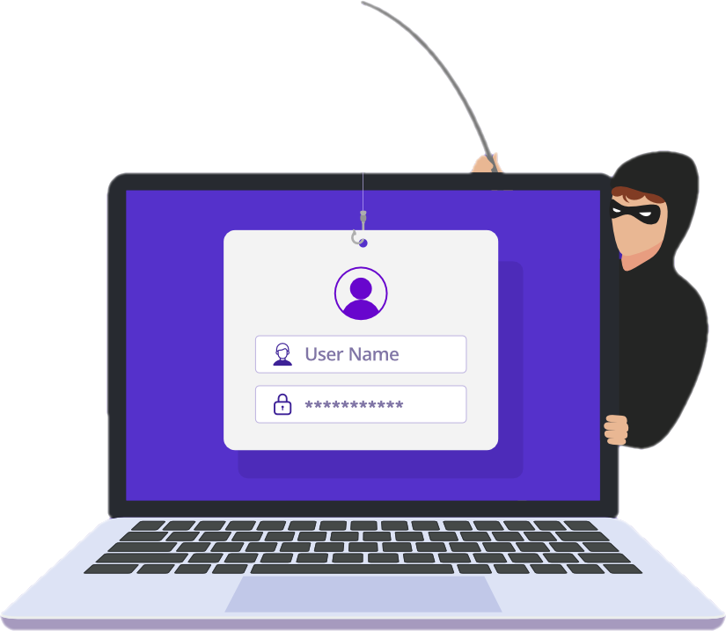
INTRODUCTION
01
Phishing is a type of cyber attack.
Involves tricking individuals into revealing sensitive information.
Importance of Phishing Awareness.

Slide 4
Types of Phishing Attacks
SOCIAL ENGINEERING
EMAIL PHISHING
WEBSITE PHISHING
Manipulating individuals to divulge confidential information
Deceptive emails to extract information
Example: Impersonation, emotional manipulation.
Examples: Fake security alerts, account verification requests.
Fraudulent websites imitating legitimate ones.
Examples: Fake login pages, malicious websites.

Slide 5
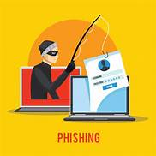
Examples Of Phishing Attacks
The example on the left is a targeted social engineering attack. Cybercriminals scan your profile for your likes and then send you a crafted message over social media trying to trick you into clicking the link, which would then steal your social media login and take over your profile sending out more phishing attacks to your friends/contact list
The one on the right is an example of a mass phishing attack through social media. No doubt many of you have seen these in Facebook, from random people in messages, or from your friends through their timelines. Upon clicking the link, it would prompt you to log in again, but this time to a fake Facebook page, and steal your log in information and take over your profile sending out the same or another mass phishing attack to your friends and contacts.

Slide 6

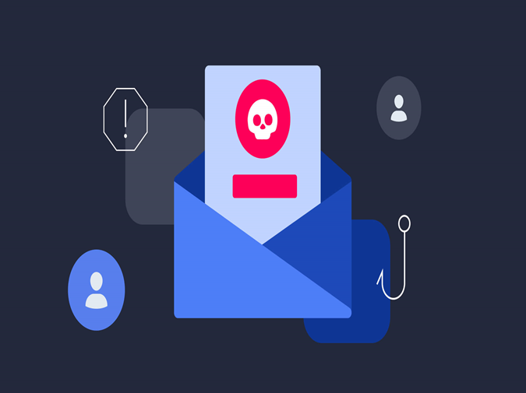
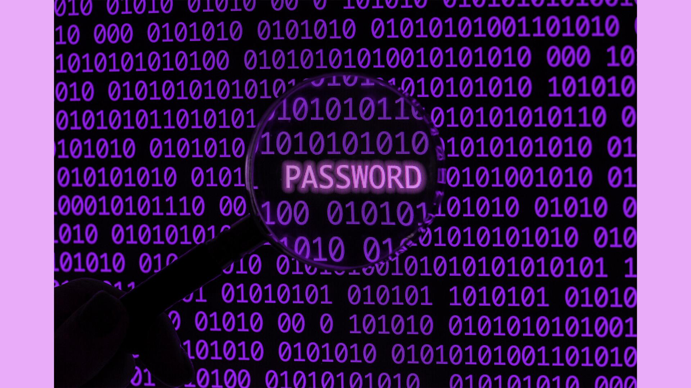
Common Characteristics of Phishing Attempts
Urgency: Creating a sense of immediate action.
Unexpected Emails: Receiving unsolicited emails.
Suspicious Links: Hover over links to preview URLs
Requests for Personal Information: Be cautious.

Slide 7

Recognizing Phishing Emails
Verify Email Content
Check the Sender's Email Address.
Hover Over Links to Preview URLs.
Look for Spelling and Grammar Mistakes.

Slide 8
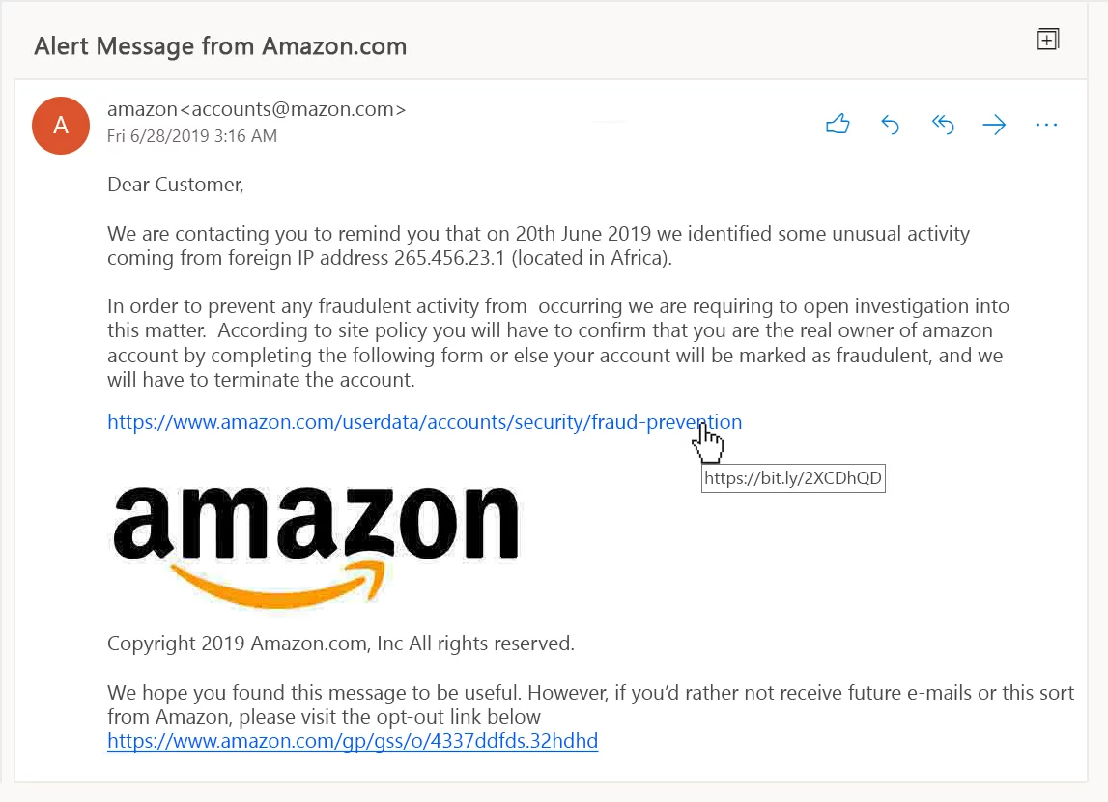
Can You Spot Any Signs Of Phishing Email

Slide 9

Recognizing Phishing Websites
Check The URL.
Verify Website Legitimacy
Look for HTTPS.
Be Cautious with Pop-Up Forms.

Slide 10

Social Engineering Tactics

Slide 11

Social Engineering Tactics
Impersonation Techniques.
Exploiting Human Emotions.
Manipulation of Trust..
Awareness of Social Media Manipulation.

Slide 12
Protecting Personal Information
Never Share Passwords via Email.
Use Two-Factor Authentication
Verify Requests for Sensitive Information.
Be Cautious with Personal Information Sharing.

Slide 13
Case studies

Slide 14

CASE STUDIES
Executive Impersonation for Sensitive Data:
Attack: Cybercriminals posed as high-level executives, requesting sensitive data from employees under the guise of urgent projects.
Impact: Confidential company information was exposed
Lessons Learned:
Communication Protocols: Define and enforce clear communication protocols for sensitive information requests, including verification measures.
Role-Based Training: Tailor phishing awareness training to different roles within the organization, emphasizing the potential for targeted attacks.

Slide 15
CASE STUDIES
01
I Keep Software Updated and Use Security Software
02
IEducate and Train Employees.
03
Regularly Backup Important Data

Slide 16

THANK YOU!
I appreciate your time and engagement in today's presentation on protecting against phishing attacks.

Slide 17
THANK YOU!
I appreciate your time and engagement in today's presentation on protecting against phishing attacks.

